Slide 1
Architecture Smells Dataset Experiment

Slide 2
Welcome
We invite you to help us to build an architecture smell annotated dataset.
There are no right or wrong answers.
The goal is to create a dataset based on human perception of software architectures.

Slide 3
Architecture Smells
Architecture smells are indicators of poor architectural design that affect multiple components and impact the entire system.
In these study you need to evaluated the following smells:
God Component
Unstable Dependency
Insufficient Modularization
Hub-like Modularization
In the next slides, we present the main concepts of each of these smells.

Slide 4
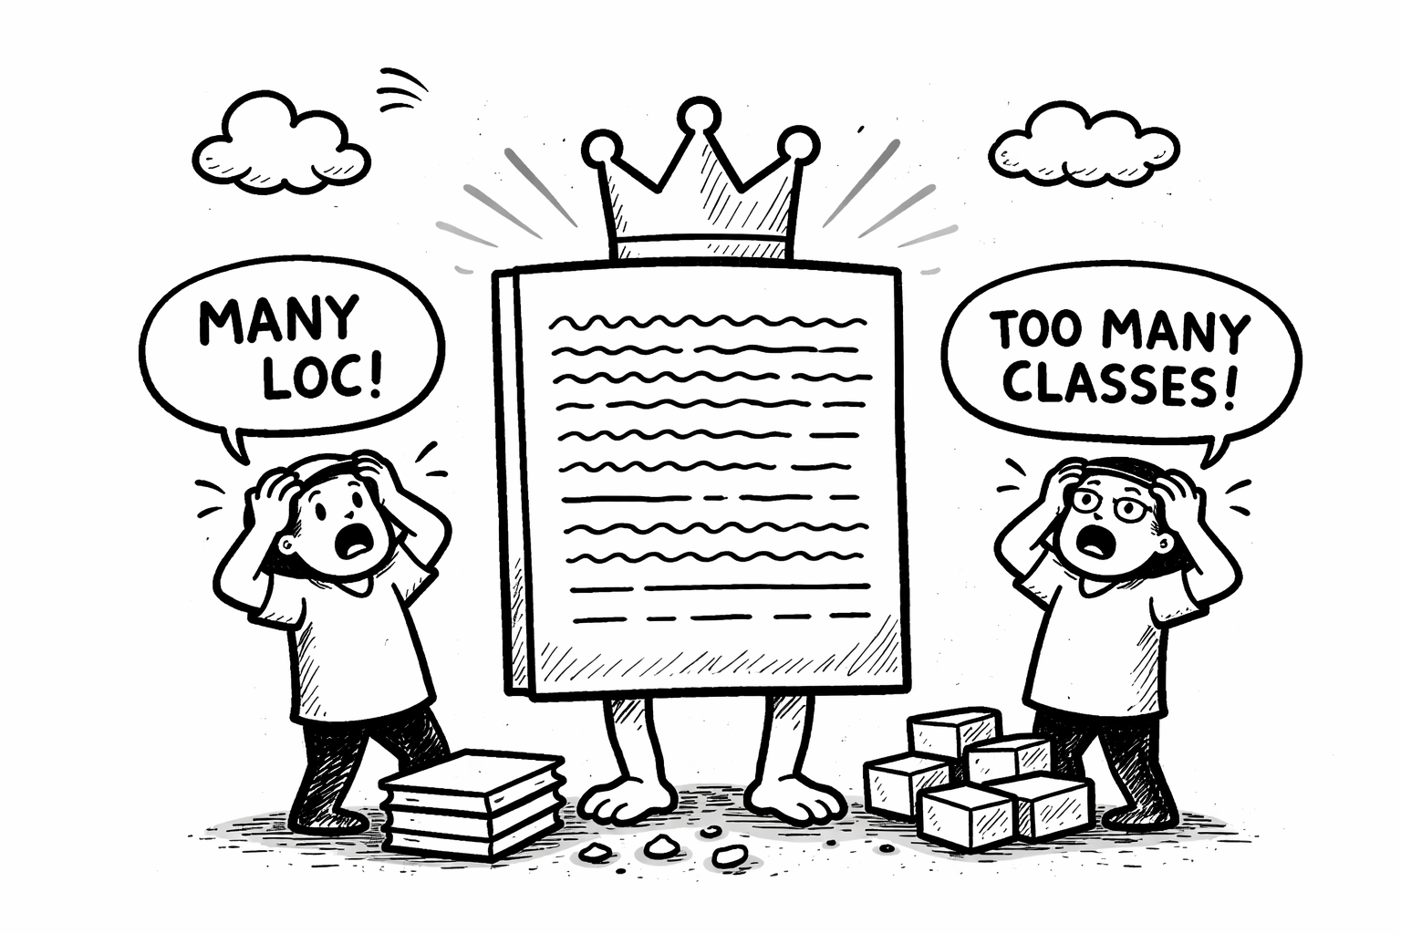
God Component - Definition
This smell occurs when a component is excessively large either in terms of Lines Of Code (LOC) or the number of classes (NOC)
generated by chatGPT

Slide 5
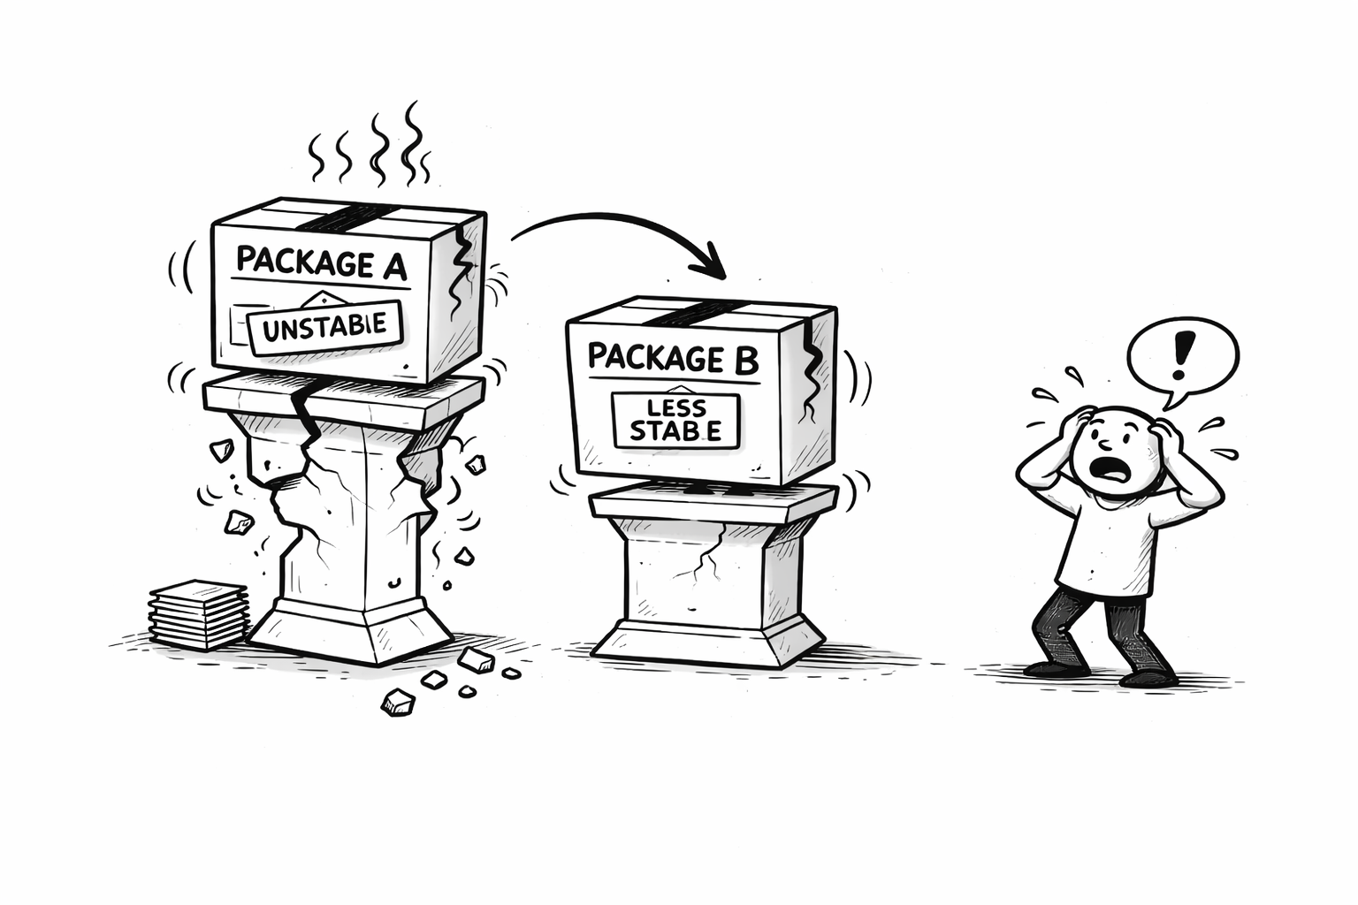
Unstable Dependency - Definition
This smell arises when a package depends on other less stable package.
Instability of a package is computed as follows:
Ce
I =
Ce + Ca
generated by chatGPT
Ca - Afferent Coupling (incoming coupling)
Ce - Efferent Coupling (outcoming coupling)

Slide 6
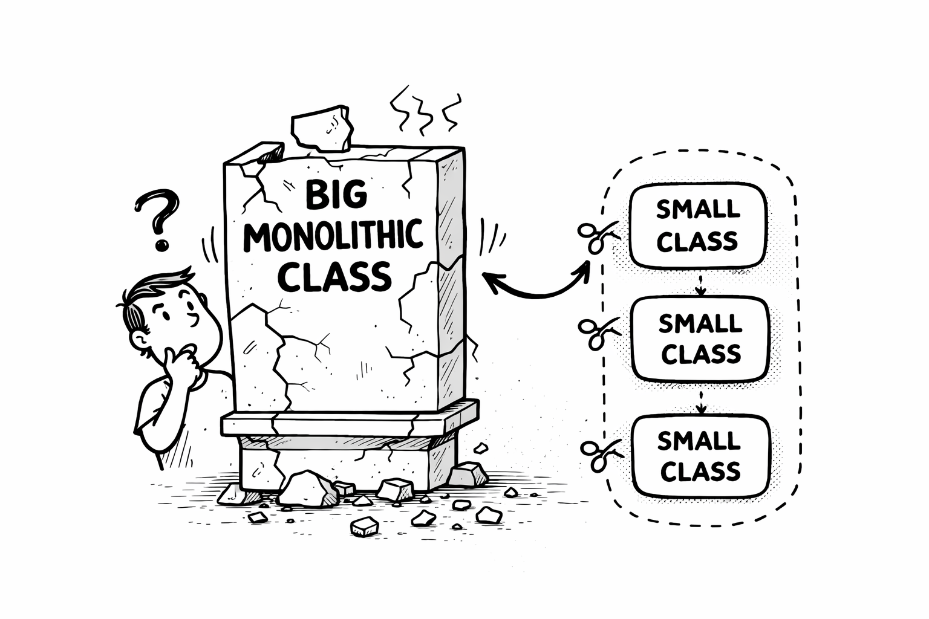
Insufficient Modularization- Definition
This smell arises when a class exists that has not been completely decomposed, and a further decomposition could reduce its size, implementation complexity, or both.
generated by chatGPT

Slide 7
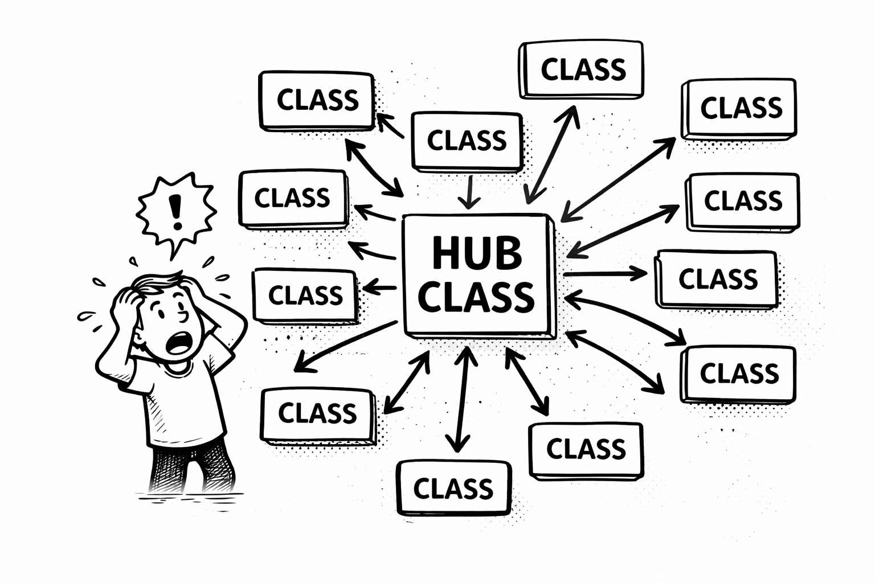
Hub-like Modularization- Definition
This smell arises when a class has dependencies (both incoming and outgoing) with a large number of other classes.
Any change to a class, on which many other classes depend, is difficult to change because the change in the class may lead to changes in the classes that depend on this class.
generated by chatGPT

Slide 8
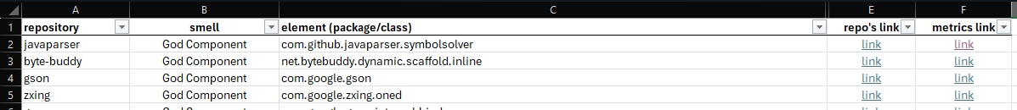
Walkthrough
We give to you a list of packages and classes in XLSX (Excel) format.
Each of these elements have the following links:
repo link: a reference for its code on GitHub.
metrics link: the metrics and dependencies of the element.
Use these information to decided if an element is affected (or not) by the given architecture smell.

Slide 9
Package Smells - Metrics
{
"package": "package fqn",
"metrics": {
"num_classes": 3,
"loc": 00, # lines of code
"Ce": 00, # efferent (outcome) coupling
"Ca": 00 # afferent (income) coupling
},
"classes": [
{
"class": "class_name",
"metrics": { class_metrics_list },
"dependencies": [ outcome_class_dependencies ],
"dependents": [ income_class_dependencies ]
}
],
"dependencies": [ outcome_package_dependencies ],
"dependents": [ income_package_dependencies ]
}
Class Metrics Glossary: https://www.designite-tools.com/docs/features_cs_new.html

Slide 10
Class Smells - Metrics
{
"class": "class_name",
"metrics": { class_metrics_list },
"dependencies": [ outcome_class_dependencies ],
"dependents": [ income_class_dependencies ]
}
"dependencies": [ outcome_package_dependencies ],
"dependents": [ income_package_dependencies ]
}
Class Metrics Glossary: https://www.designite-tools.com/docs/features_cs_new.html

